Slide 1
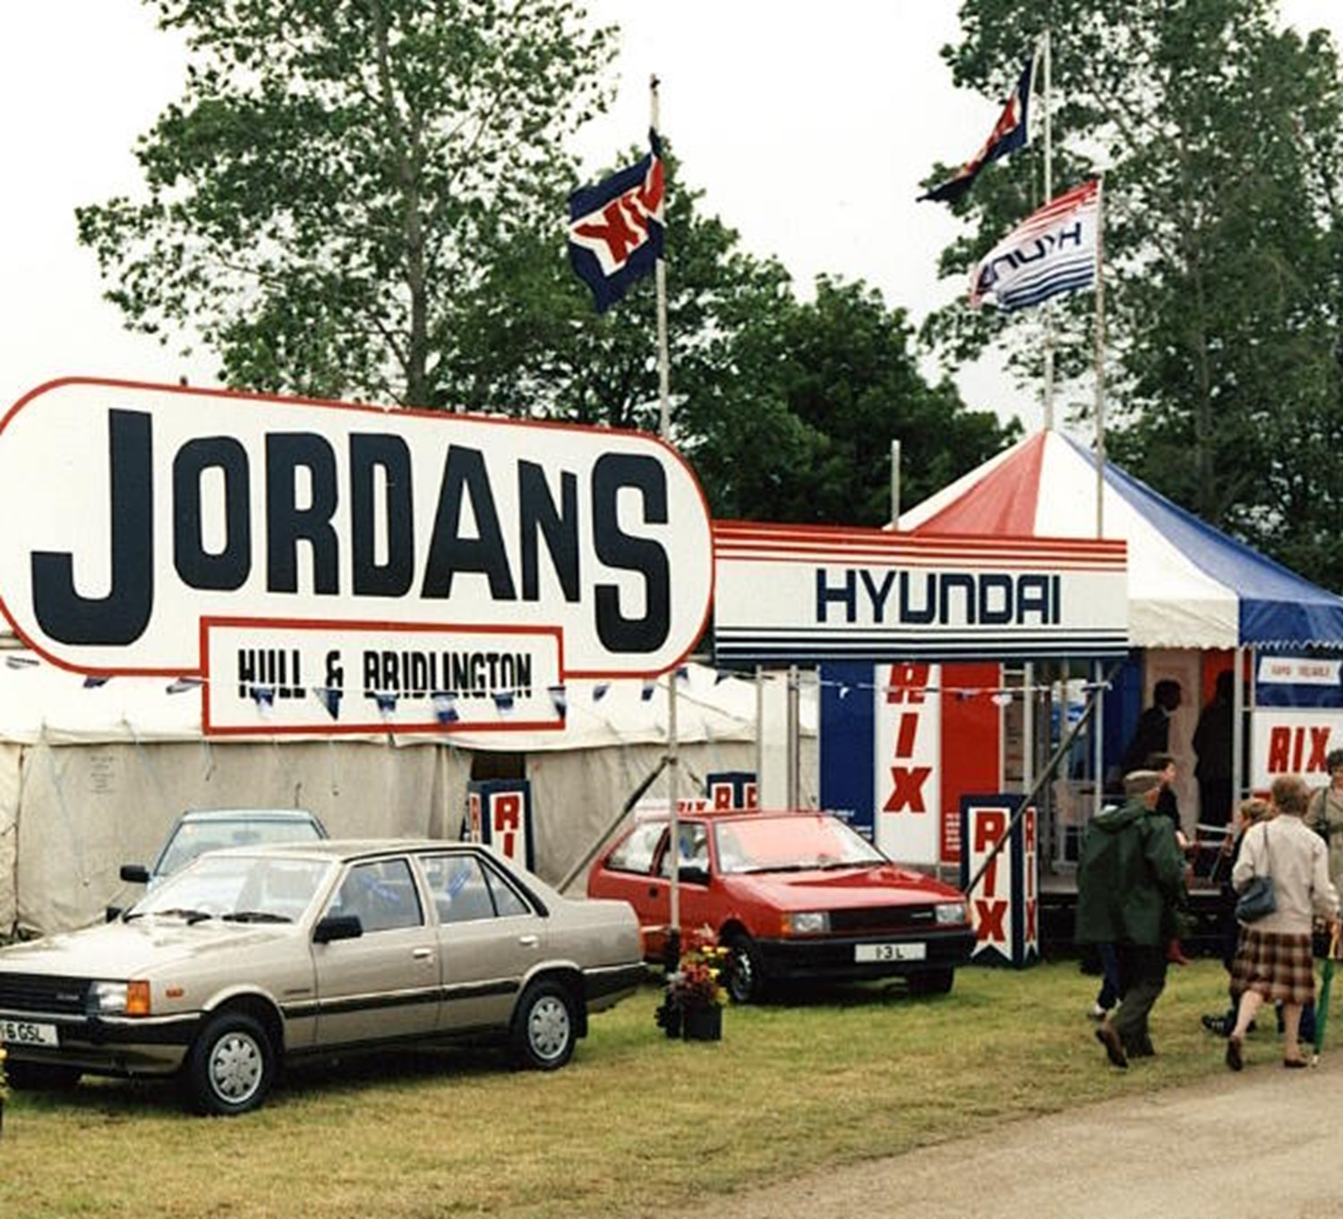
Agents, fiduciaries and commissions: is your contract safe?

Slide 2
Rukhadze v Recovery Partners
Lord Briggs
[50] ‘Fiduciary duties have been an important part of what makes business distinguishable from an uncontrolled free for all for as long as there have been company directors, commercial agents, partnerships and legal services supplied by solicitors. The fact that such relationships have increased in line with the enormous expansion of business and financial services only serves to underline the importance of encouraging the making of business relationships involving single-minded loyalty, and the reinforcement of those relationships provided by long established law.’

Slide 3
‘Three-Cornered Transaction’
Customer
Lender
Dealer

Slide 4
‘Main Issue’
[57] ‘whether the continuing status of the dealer as seller of the car in the three-cornered transaction between dealer, lender and customer is fatal to the recognition of any fiduciary duty owed by dealer to customer in connection with providing a finance package as credit broker sufficient to ground a claim in dishonest assistance by the lender, or any lesser “disinterested” duty (whether as agent or otherwise) to avoid being affected by personal interest, sufficient to found a claim against the lender in bribery.’

Slide 5
Hopcraft
An Undertaking
[96] ‘It is consistent with the court’s practice of recognising fiduciary duties by analogy to well-established categories of fiduciary that fiduciary duties arise where a person consciously assumes (or undertakes) responsibility in relation to the management of the property or affairs of another, in circumstances where he or she knows or ought to appreciate that this carries with it the expectation that he or she will act with loyalty to that other in that regard. That person undertaking that task does not have to have a subjective awareness of the duty of loyalty and the specific legal duties that that entails.’

Slide 6
When do fiduciary duties arise?

Slide 7
The Task
[83] ‘In a commercial setting the task is to find in a particular context the boundary between normal (self-interested) arm's length activity and the circumstances in which equity recognises fiduciary duties of one of the commercial parties requiring that party to put aside his or her own interests and act altruistically in the interests of another.’

Slide 8
Singled-minded loyalty – abnegation of self-interest
[90] ‘The key principle is therefore that a fiduciary acts for and only for another. He owes a duty of single-minded loyalty to his principal, meaning that he cannot exercise any power in relation to matters covered by his fiduciary duty so as to benefit himself.’

Slide 9
Trust and Confidence?
[108] ‘Equity analyses objectively the relationship between the parties to ascertain whether it involves a relationship of trust and confidence because a party has, or is treated as having, undertaken to act with the loyalty of which Millett LJ spoke in Mothew. The relationship of trust and confidence is the consequence, and not the cause, of a fiduciary duty. The fiduciary duty exists because the fiduciary has undertaken not to pursue his own interests.’

Slide 10
Vulnerability?
[108] ‘the vulnerability which is the typical characteristic of a person to whom a fiduciary duty is owed, is a consequence and not a cause of a fiduciary relationship. It is because the fiduciary has undertaken to act solely in the best interests of the principal, and the latter trusts the fiduciary to do so, in a situation where it is usually possible for the fiduciary to act in a self-interested way, that the vulnerability typically arises.’

Slide 11
Commercial Context?
[102] ‘It is important not to distort the commercial bargain between the parties to a contract by too readily implying fiduciary obligations into the commercial relationship.’

Slide 12
The Tort of Bribery?

Slide 13
Tort of Bribery?
[187] ‘In every case we have cited in which a claim based on bribery was upheld, the recipient of the benefit was someone who owed a fiduciary obligation, and the receipt of the benefit resulted in a breach of the no conflict rule.’

Slide 14
Tort of Bribery?
[199] ‘We accept that the civil law of bribery is not confined to the established categories of fiduciary relationships. However, it was in our view a mistake to hold that a fiduciary relationship was unnecessary. As we have explained, a relationship is properly described as fiduciary where one party to the relationship owes a fiduciary duty of loyalty to the other, even if the relationship does not fall within one of the established categories or involve the full range of fiduciary duties.’

Slide 15
Hopcraft
Bribery and Fiduciaries
[207] ‘We conclude that the Court of Appeal was mistaken, in the present case, to proceed on the basis that it was unnecessary, in order for liability for bribery to arise at common law, that the recipient of the payment should owe a fiduciary duty of loyalty to the claimant. Civil liability for bribery cannot arise unless such a duty was owed. Such a duty may arise in circumstances where one person has performed a role in another person's decision-making process by exercising judgement or discretion in relation to the interests and affairs of that other person. However, whether it does so will depend on a number of factors, including whether the person undertook or agreed to act in that person's interests to the exclusion of any interest of their own.’

Slide 16
Implications?

